Slide 1



UNIVERSITY INSTITUTE OF ENGINEERING
COMPUTER SCIENCE ENGINEERING
Bachelor of Engineering
Design and Analysis of Algorithms(CST-302/ITT-302)
Prepared By: Amrita Chaudhary (E8745)
Topic: Huffman coding, Optimal Merge tree
DISCOVER . LEARN . EMPOWER

Slide 2
Learning Objectives & Outcomes
Objective:
To understand the concept of Huffman coding and optimal merge pattern.
Outcome:
Student will understand
Huffman coding
Optimal merge pattern

Slide 3
Huffman Coding
Prefix Codes, means the codes (bit sequences) are assigned in such a way that the code assigned to one character is not the prefix of code assigned to any other character. This is how Huffman Coding makes sure that there is no ambiguity when decoding the generated bitstream.
There are mainly two major parts in Huffman Coding
1) Build a Huffman Tree from input characters. 2) Traverse the Huffman Tree and assign codes to characters.

Slide 4
Steps to build Huffman Tree
Input is an array of unique characters along with their frequency of occurrences and output is Huffman Tree.
1. Create a leaf node for each unique character and build a min heap of all leaf nodes (Min Heap is used as a priority queue. The value of frequency field is used to compare two nodes in min heap. Initially, the least frequent character is at root)
2. Extract two nodes with the minimum frequency from the min heap.
3. Create a new internal node with a frequency equal to the sum of the two nodes frequencies. Make the first extracted node as its left child and the other extracted node as its right child. Add this node to the min heap.
4. Repeat steps#2 and #3 until the heap contains only one node. The remaining node is the root node and the tree is complete.

Slide 5
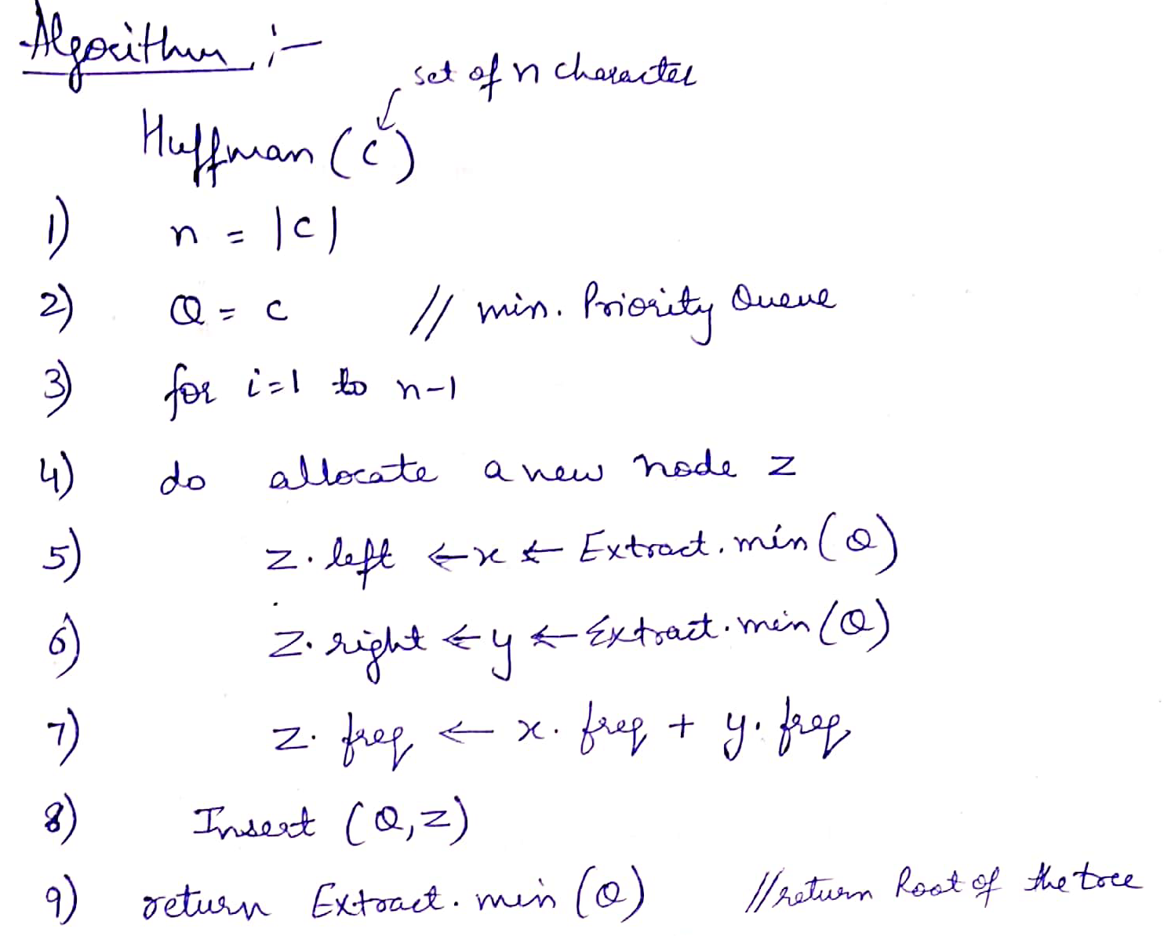
Algorithm

Slide 6
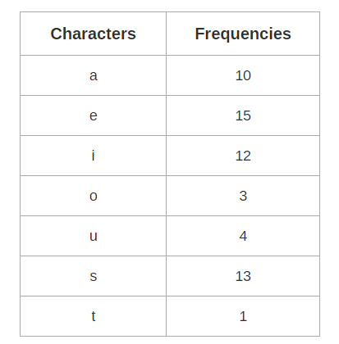
Example
PROBLEM:
A file contains the following characters with the frequencies as shown. If Huffman Coding is used for data compression, determine-
1) Huffman Code for each character
2) Average code length
3) Length of Huffman encoded
message (in bits)

Slide 7
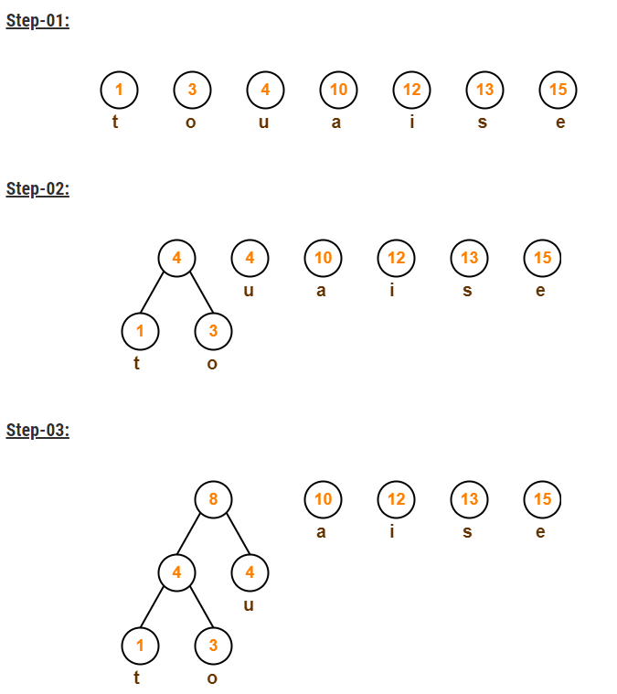
Solution

Slide 8
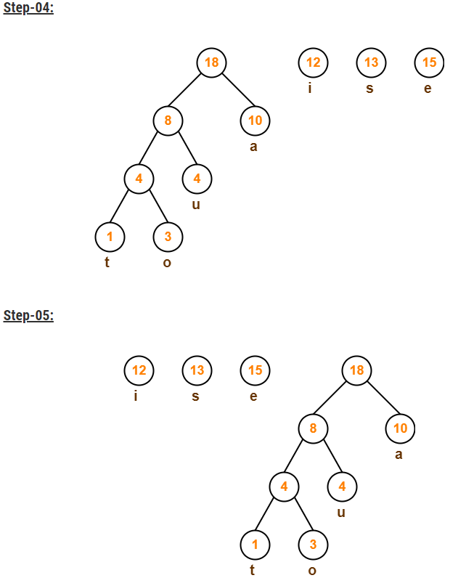

Slide 9
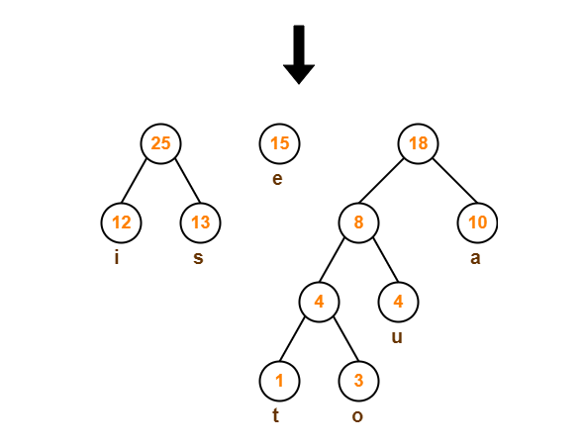

Slide 10
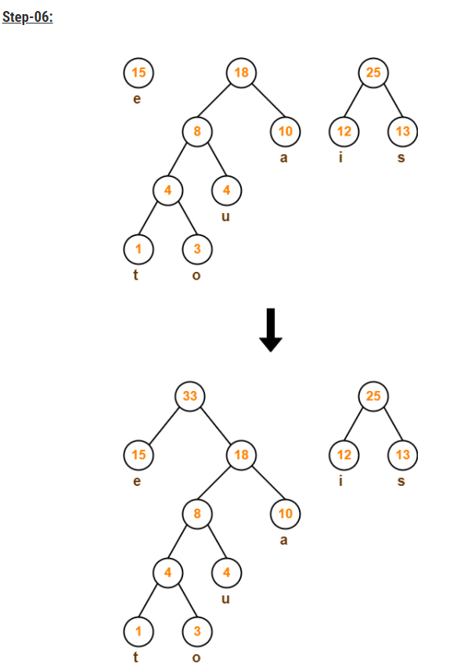

Slide 11
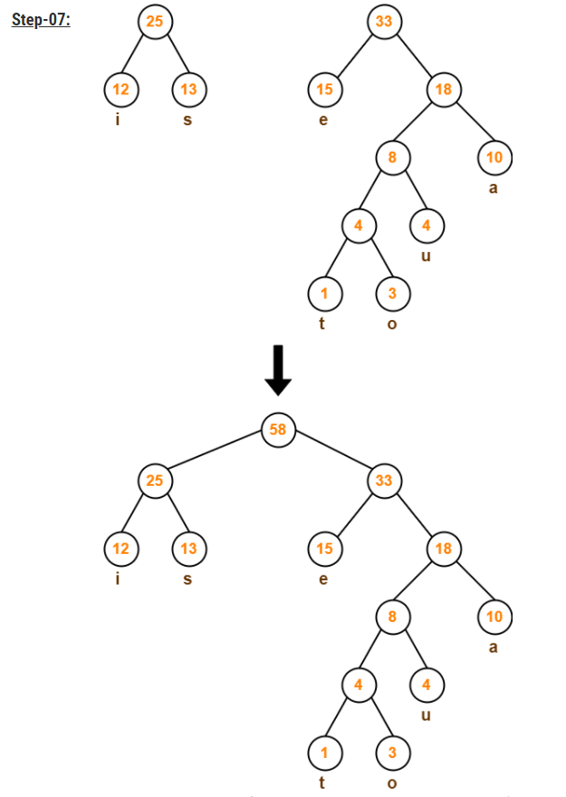

Slide 12
Now,
We assign weight to all the edges of the constructed Huffman Tree.
Let us assign weight ‘0’ to the left edges and weight ‘1’ to the right edges.

Slide 13
Rule
If you assign weight ‘0’ to the left edges, then assign weight ‘1’ to the right edges.
If you assign weight ‘1’ to the left edges, then assign weight ‘0’ to the right edges.
Any of the above two conventions may be followed.
But follow the same convention at the time of decoding that is adopted at the time of encoding.

Slide 14
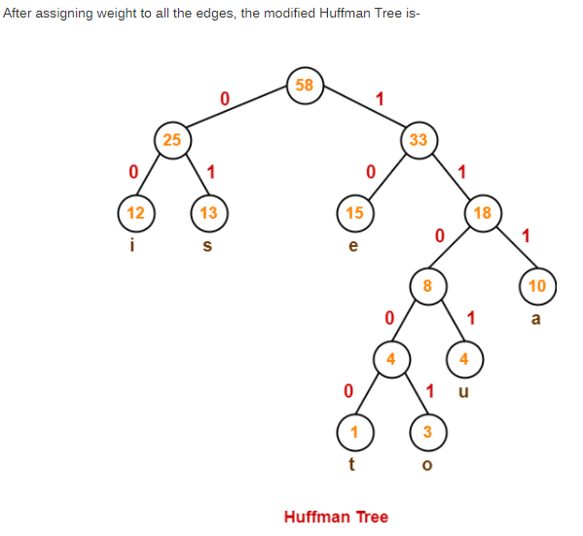

Slide 15
Answers based on previous huffman tree
1. Huffman Code For Characters-
To write Huffman Code for any character, traverse the Huffman Tree from root node to the leaf node of that character.
Following this rule, the Huffman Code for each character is-
a = 111
e = 10
i = 00
o = 11001
u = 1101
s = 01
t = 11000
From here, we can observe-
Characters occurring less frequently in the text are assigned the larger code.
Characters occurring more frequently in the text are assigned the smaller code.

Slide 16
2. Average Code Length-
Using formula-01, we have-
Average code length
= ∑ ( frequency_{i} x code length_{i} ) / ∑ ( frequency_{i} )
= { (10 x 3) + (15 x 2) + (12 x 2) + (3 x 5) + (4 x 4) + (13 x 2) + (1 x 5) } / (10 + 15 + 12 + 3 + 4 + 13 + 1)
= 2.52

Slide 17
3. Length of Huffman Encoded Message-
Using formula-02, we have-
Total number of bits in Huffman encoded message
= Total number of characters in the message x Average code length per character
= 58 x 2.52
= 146.16
≅ 147 bits

Slide 18
Poll Question
Which of the following algorithms is the best approach for solving Huffman codes?
a) exhaustive search
b) greedy algorithm.
c) brute force algorithm
d) divide and conquer algorithm

Slide 19
Poll Question
2) The code length does not depend on the frequency of occurrence of characters.
a) true
b) false.

Slide 20
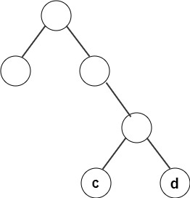
Poll Question
3) From the following given tree, what is the computed codeword for ‘c’?
a) 111
b) 101
c) 110
d) 011

Slide 21
Optimal merge patterns
Merge a set of sorted files of different length into a single sorted file. We need to find an optimal solution, where the resultant file will be generated in minimum time.
If the number of sorted files are given, there are many ways to merge them into a single sorted file. This merge can be performed pair wise. Hence, this type of merging is called as 2-way merge patterns.
As, different pairings require different amounts of time, in this strategy we want to determine an optimal way of merging many files together. At each step, two shortest sequences are merged.

Slide 22
To merge a p-record file and a q-record file requires possibly p + q record moves, the obvious choice being, merge the two smallest files together at each step.
Two-way merge patterns can be represented by binary merge trees. Let us consider a set of n sorted files {f₁, f₂, f₃, …, f_{n}}. Initially, each element of this is considered as a single node binary tree. To find this optimal solution, the following algorithm is used.

Slide 23
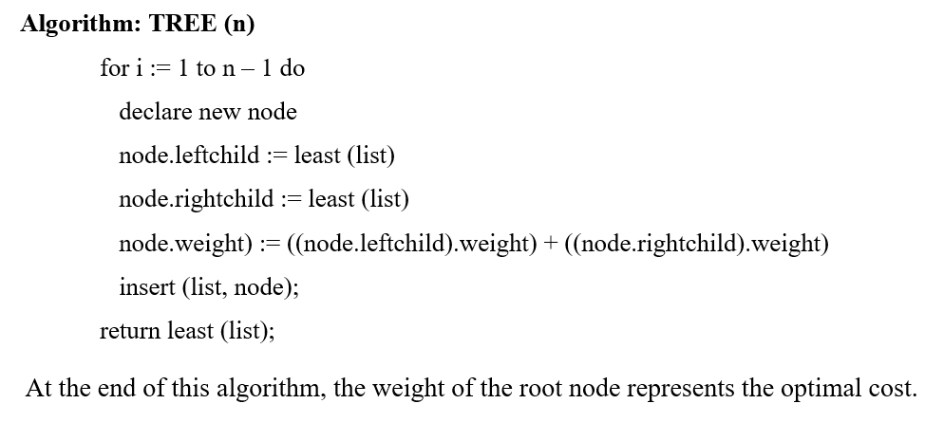
Algorithm

Slide 24
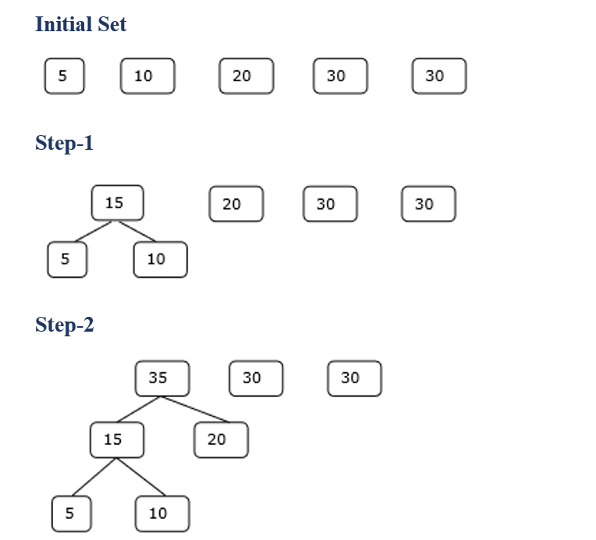
Example

Slide 25
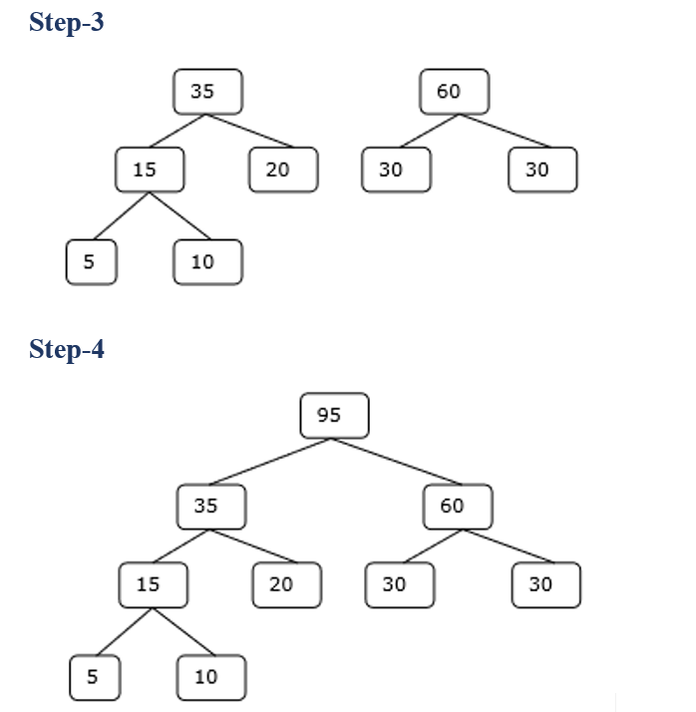
Hence, the solution takes 15 + 35 + 60 + 95 = 205 number of comparisons.

Slide 26
Poll Question
4) What will be the cost of the code if character c_{i} is at depth d_{i} and occurs at frequency f_{i}?
a) c_{i}f_{i}
b) ∫c_{i}f_{i}
c) ∑f_{i}d_{i.}
d) f_{i}d_{i}

Slide 27
REFERENCES
Text books:
Cormen, Leiserson, Rivest, Stein, “Introduction to Algorithms”, Prentice Hall of India, 3rd edition 2012. problem, Graph coloring.
Websites:
https://www.geeksforgeeks.org/huffman-coding-greedy-algo-3/
https://www.programiz.com/dsa/huffman-coding
https://www.tutorialspoint.com/design_and_analysis_of_algorithms/design_and_analysis_of_algorithms_optimal_merge_pattern.htm#:~:text=Merge%20a%20set%20of%20sorted,into%20a%20single%20sorted%20file.

Slide 28
Summary
    Huffman Coding
    Optimal Merge Pattern

Slide 29
THANK YOU

